Slide 1

Generating Cloud Monitors from Models to Secure Clouds
Prepared by: Tumu Srikanth
Roll No: 130522860291
Submitted To: Mrs. Annapurna Vege,
Assistant Professor,
Avanthi PG College

Slide 2
Abstract
Authorization represents a significant security risk in cloud computing environments, as it governs user access to system resources. The complexity and error-prone nature of enforcing security standards are exacerbated by the multitude of resources typically associated with REST APIs in the cloud. This research proposes the implementation of a security cloud monitor to address this challenge. Utilizing a model-driven approach, we articulate the functional and security requirements, which subsequently guide the creation of cloud monitors. These monitors incorporate contracts designed to automatically verify compliance with security implementations. We develop the cloud monitor using the Django web framework and validate our solution within the OpenStack ecosystem.

Slide 3
Introduction
Private clouds are vital for data center modernization, with 72% of cloud users utilizing private clouds and 67% using hybrid clouds, according to the 2017 Cloud Survey. These environments, used by organizations ranging from 500 to over 2,000 employees, pose significant security and engineering challenges.
Cloud services often use REST APIs (Representational State Transfer Application Programming Interfaces) to provide access to resources like AWS, Azure, and OpenStack. Each resource is accessed via a unique URI, leading to numerous potential entry points. Ensuring the security of each URI to prevent data breaches and privilege escalation is critical and complex.
Open-source cloud systems like OpenStack are frequently updated, which can compromise existing security features. This necessitates advanced monitoring systems as manual verification of API access control becomes impractical. This research proposes a semi-automated cloud monitoring system to ensure compliance between private cloud implementations and API access control policies. We use UML (Unified Modeling Language) models with OCL (Object Constraint Language) to define the behavioral interface and security constraints.
Using the Design by Contract (DbC) framework, we specify functional and security requirements as verifiable contracts. This approach enables the creation of a stateful wrapper for modeling usage scenarios and defining secure behavioral contracts, aiding requirements tracing and security verification.
Our methodology is applied using OpenStack and the Django web framework, resulting in promising validation outcomes. This paper's structure is as follows: Section II discusses the motivation for our work, Section III provides an overview of our cloud monitoring framework, Section IV details our design methodology for stateful REST service modeling, and Section V describes the contract generation technique.

Slide 4
Existing System Drawbacks
Existing System
Private clouds are essential for data center transformations, providing dedicated environments for single organizations. Designing secure private clouds for numerous users presents a significant engineering challenge. Cloud services typically offer REST APIs (REpresentational State Transfer Application Programming Interfaces), each exposing information through a unique URI, leading to a proliferation of access points.
Disadvantages of Existing System
Data Breaches: High risk of data breaches and loss of critical data.
Security Complexity: The vast number of URIs complicates security management, increasing the risk of unauthorized access and privilege escalation.
Frequent Updates: Open-source cloud code is frequently updated, potentially compromising previous security features.

Slide 5
Proposed System and Its Advantages
PROPOSED SYSTEM:
We present a cloud monitoring framework that supports a semi-automated approach to monitoring a private cloud implementation with respect to its conformance to the functional requirements and API access control policy. Our work uses UML (Unified Modeling Language) models with OCL (Object Constraint Language) to specify the behavioral interface with security constraints for the cloud implementation. The behavioral interface of the REST API provides an information regarding the methods that can be invoked on it and pre- and post-conditions of the methods. In the current practice, the pre- and post-conditions are usually given as the textual descriptions associated with the API methods. In our work, we rely on the Design by Contract (DbC) framework, which allows us to define security and functional requirements as verifiable contracts.
ADVANTAGES OF PROPOSED SYSTEM:
Our methodology enables creating a (stateful) wrapper that emulates the usage scenarios and defines security-enriched behavioural contracts to monitor cloud.
The proposed approach also facilitates the requirements traceability by ensuring the propagation of the security specifications into the code. This also allows the security experts to observe the coverage of the security requirements during the testing phase.
The approach is implemented as a semi-automatic code generation tool in Django a Python web framework.

Slide 6
System Requirements
Hardware Requirements:
Processor: Pentium Dual Core
Hard Disk: 500 GB
Monitor: 15" LED
Input Devices: Keyboard, Mouse
RAM: 1 GB
Software Requirements:
Operating System: Windows 7
Coding Language: Python
Tools: PyCharm, Visual Studio Code
Database: MySQL

Slide 7
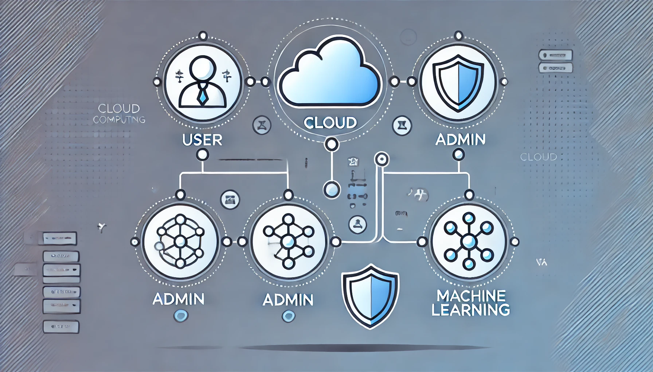
Modules Overview
The system is divided into several key modules: User, Cloud, Admin, and Machine Learning. Each module plays a crucial role in ensuring the functionality and security of the cloud environment. These modules work together to provide a robust, secure, and scalable cloud monitoring system that meets the needs of both individual users and administrators.

Slide 8
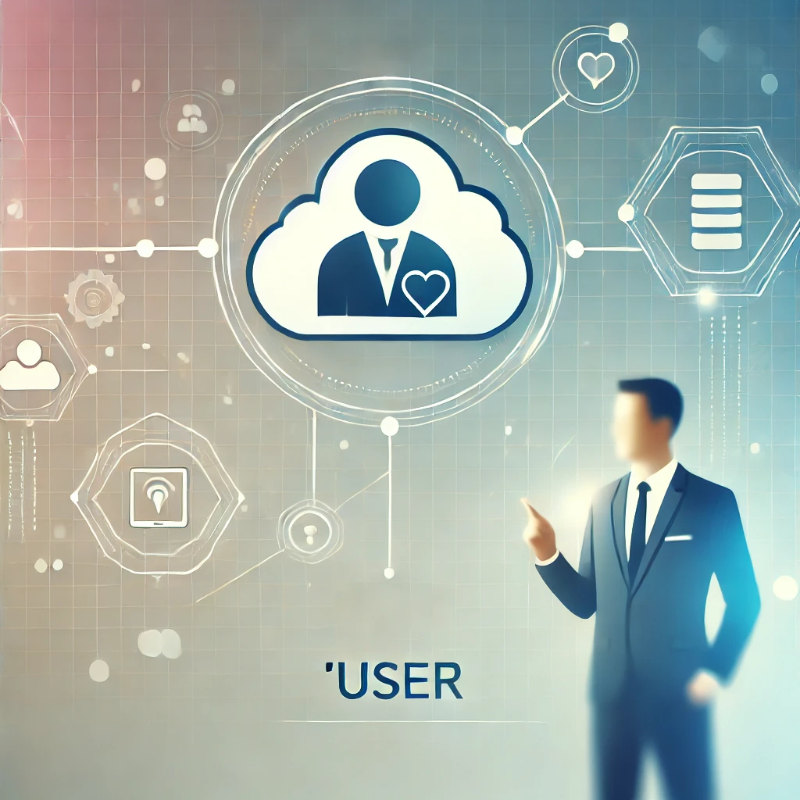
Module 1: User
The User module handles all interactions related to the cloud users. It manages tasks such as user authentication, file uploads, and cloud resource creation. The module ensures that users can securely access and manage their data within the cloud environment. It also enforces permissions, ensuring that users can only perform actions they are authorized for. This module is critical for providing a secure and user-friendly experience in the cloud.

Slide 9

Module 2: Cloud
The Cloud module is the core of the system, responsible for implementing the cloud monitoring functionality. It handles the backend processes, including data storage, resource management, and security enforcement. This module uses Django to manage cloud resources and ensure that all operations comply with the security contracts defined in the system. The cloud module interacts closely with the user and admin modules to provide seamless and secure cloud services.

Slide 10
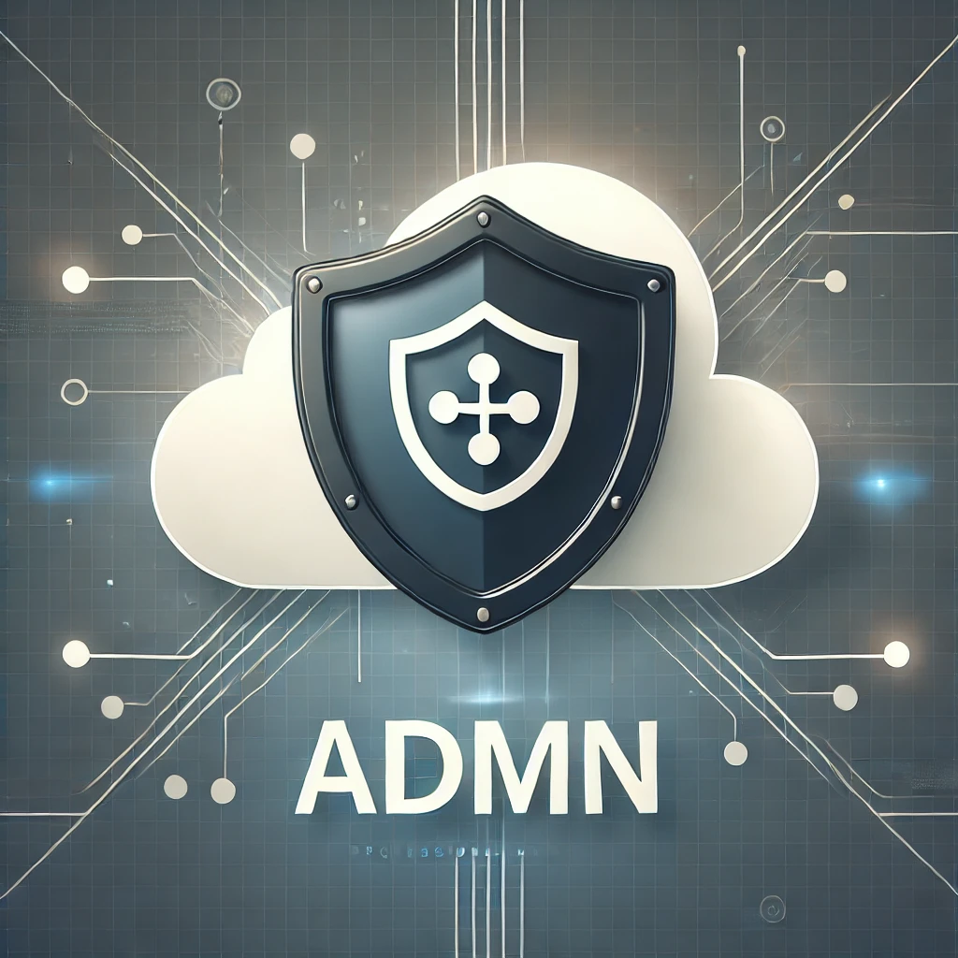
Module 3: Admin
The Admin module provides the administrative interface for managing the cloud environment. Administrators can use this module to activate or deactivate user accounts, manage permissions, and oversee cloud resources. The admin module is essential for maintaining control over the system, ensuring that users adhere to security protocols, and that cloud resources are used efficiently and securely. It serves as the supervisory component of the system, enabling admins to monitor and regulate user activities.

Slide 11

Module 4: Machine Learning
The Machine Learning module enhances the system’s capabilities by applying predictive algorithms to cloud data. This module supports advanced functionalities such as anomaly detection, resource optimization, and predictive maintenance. By analyzing patterns in the data, the machine learning module helps the system make informed decisions, improving overall efficiency and security. This module represents the system's ability to evolve and adapt based on the data it processes, making it an integral part of the cloud monitoring framework.

Slide 12
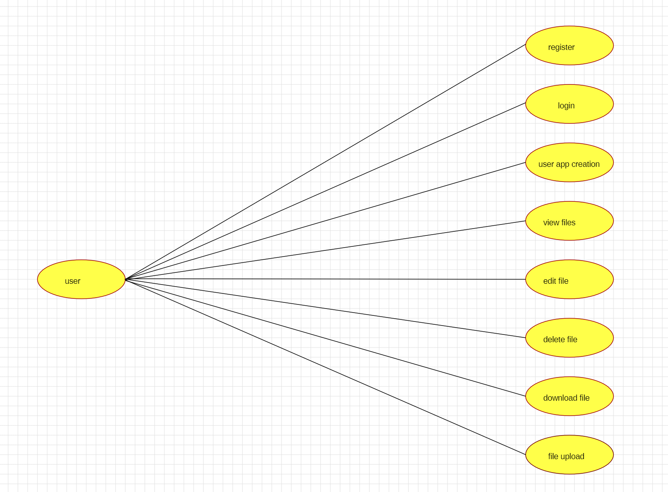
UML Use Case Diagram
Description: The Use Case Diagram visually represents the interactions between different actors in the system, such as Users, Admins, and the Cloud. It outlines the various functions that each actor can perform, like uploading files, managing resources, or monitoring security. This diagram states the system’s functionalities from an external viewpoint, showing who can perform what actions within the system. It is a critical tool for understanding the system's requirements and ensuring that all necessary features are included in the design.

Slide 13
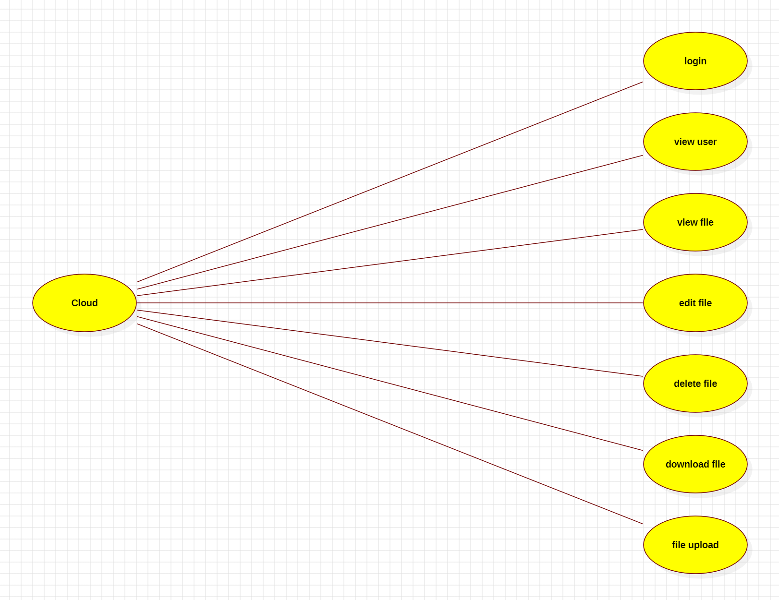
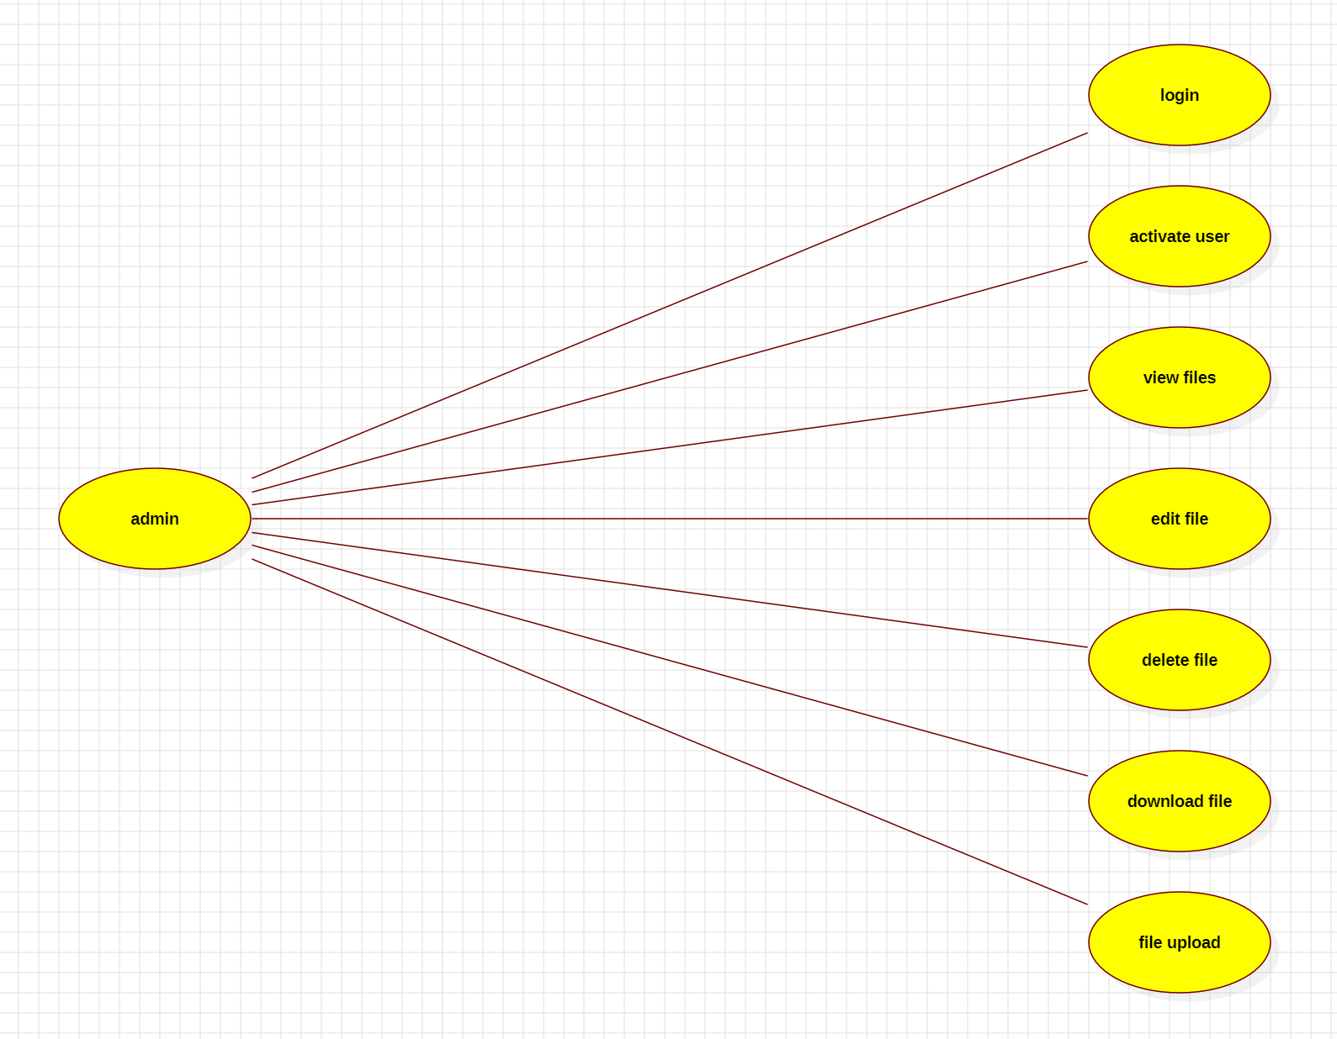
Use Case Diagram

Slide 14
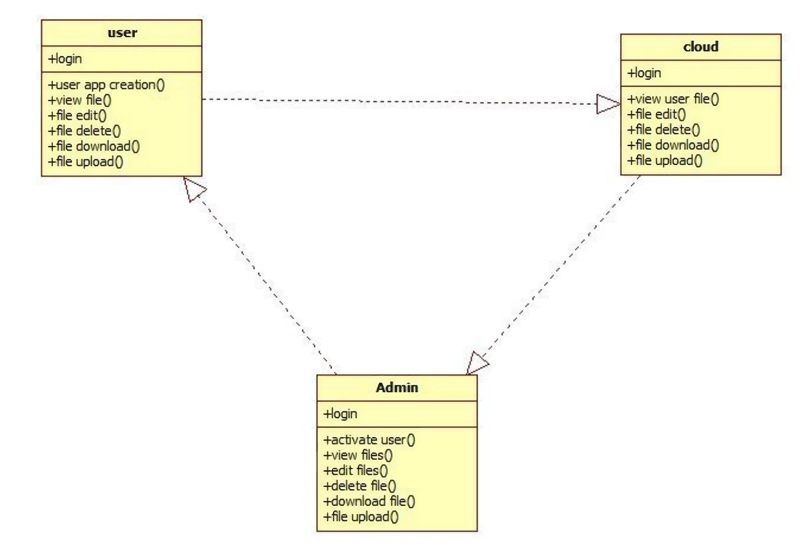
UML Class Diagram
Description: The Class Diagram provides a static view of the system’s structure, detailing the classes involved in the system and their relationships. It shows how the User, Admin, and Cloud classes are defined, including their attributes, methods, and the interactions between them. This diagram states the system’s architecture, showing how different components are organized and how they work together to fulfill the system’s objectives. It serves as a blueprint for building the system’s software components.

Slide 15
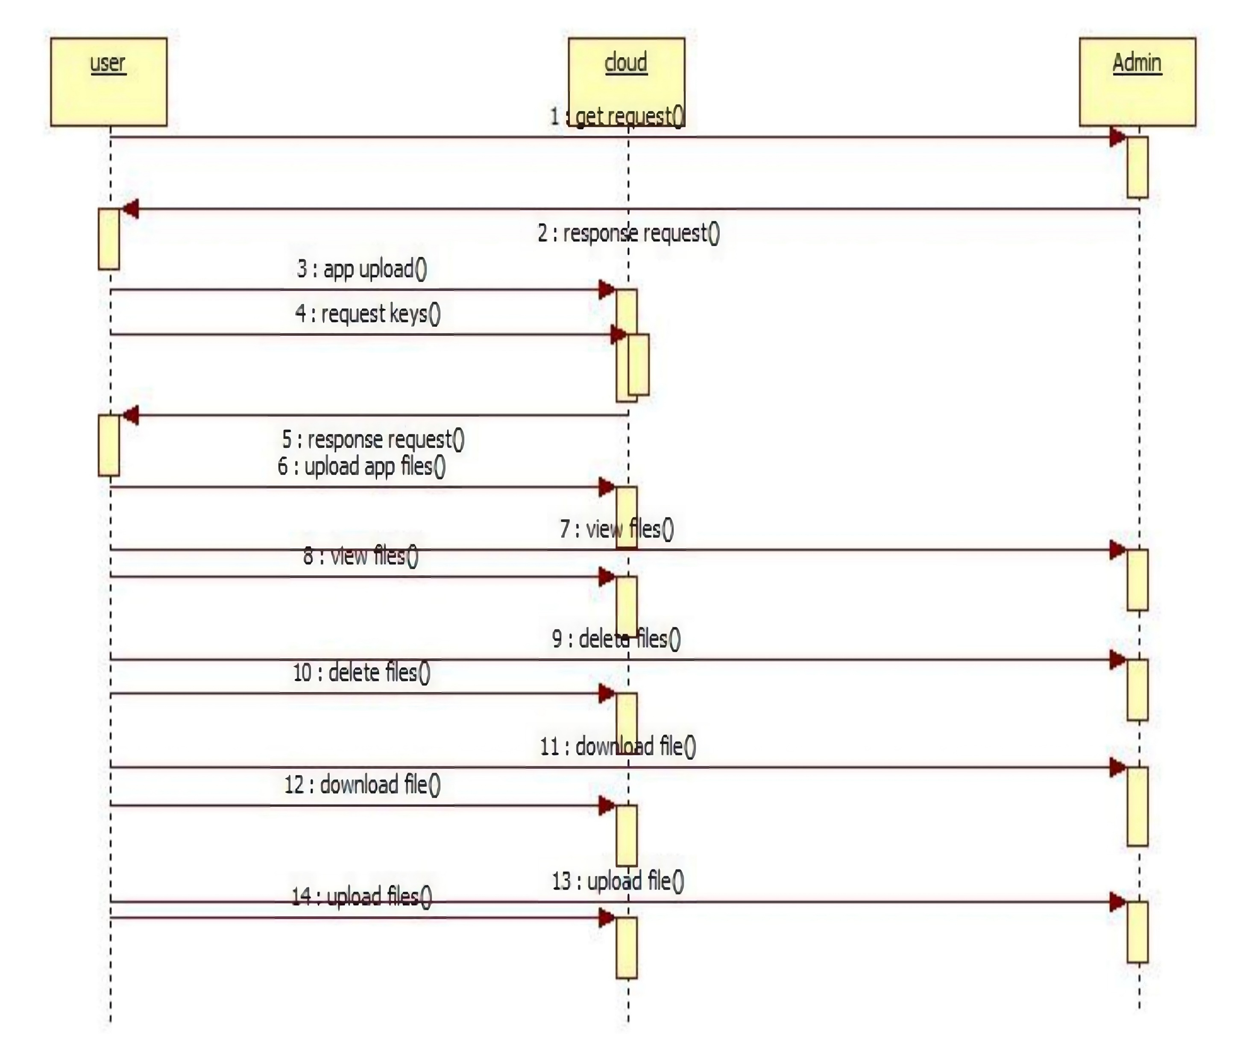
UML Sequence Diagram
Description: The Sequence Diagram captures the dynamic interactions within the system, showing how processes unfold over time. It details the order of operations when a user performs an action, such as logging in or uploading a file, and how the cloud and admin modules respond to these actions. This diagram states the temporal aspects of system interactions, highlighting the sequence of messages exchanged between objects to complete specific tasks. It is essential for understanding the flow of operations within the system.

Slide 16
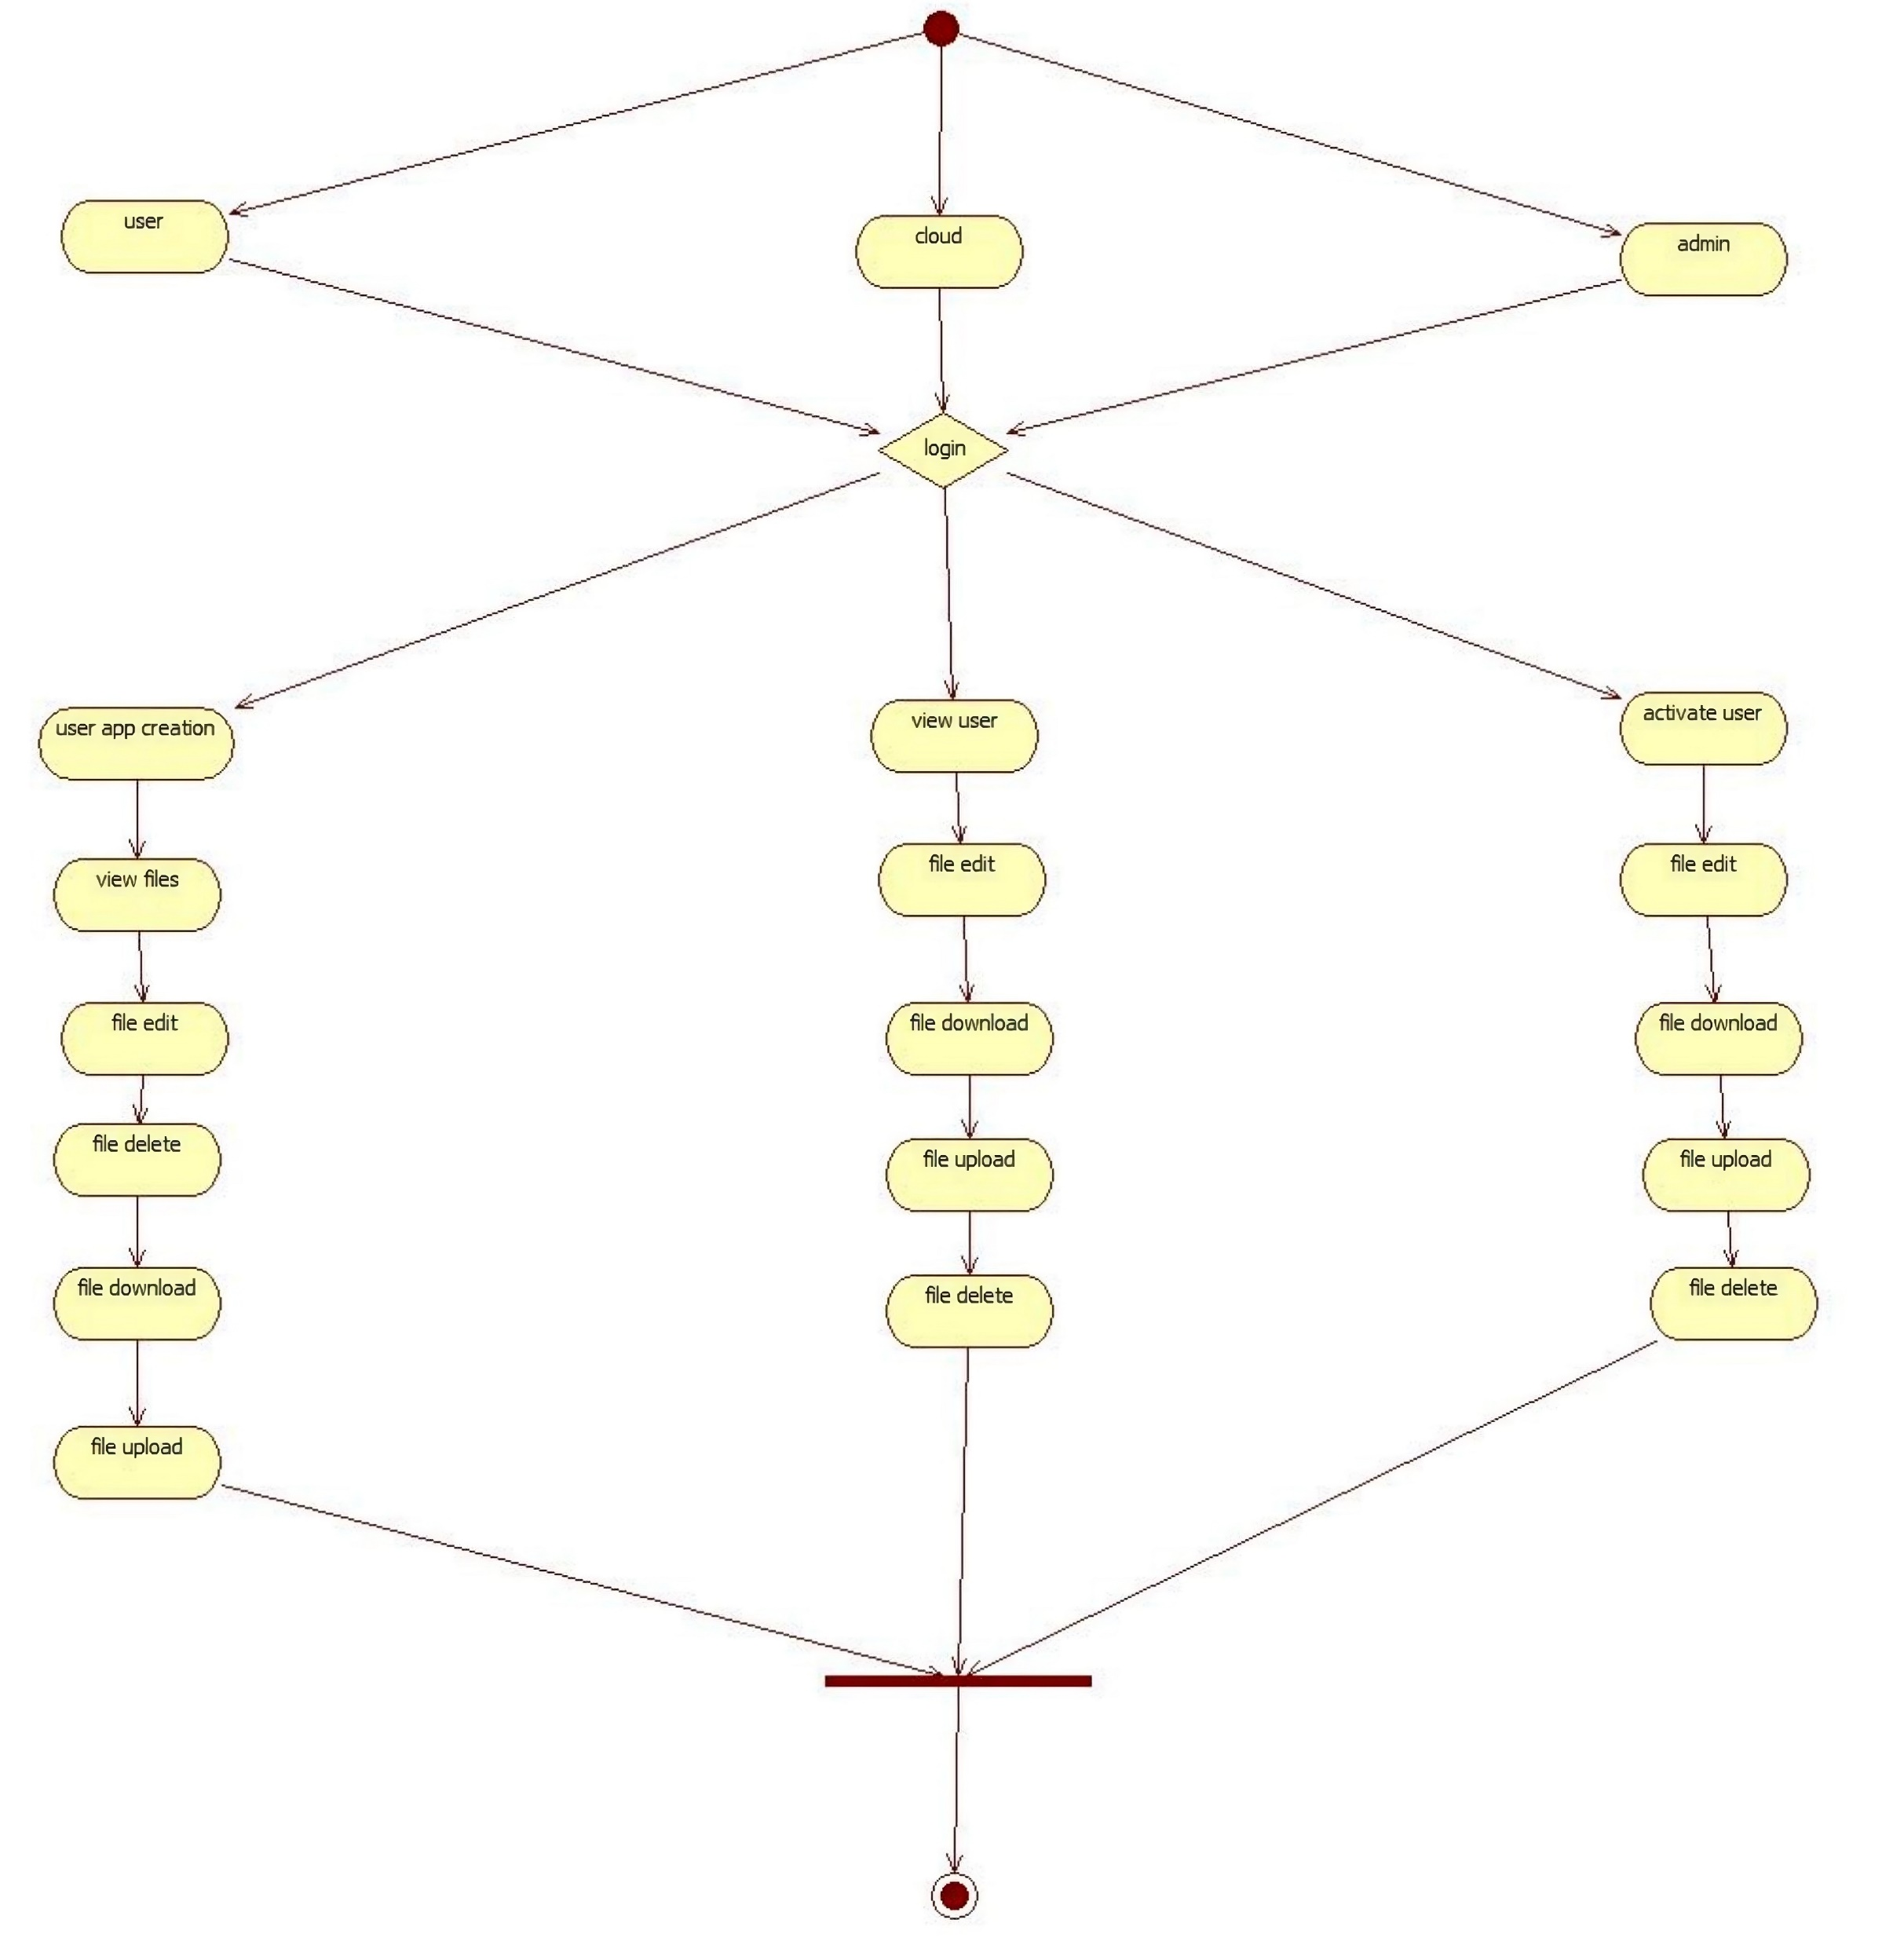
UML Activity Diagram
Description: The Activity Diagram maps out the workflow of the system, illustrating the sequence of activities performed by Users, Admins, and the Cloud. It shows how actions are linked, the decision points in processes, and how parallel activities are managed. This diagram states the logical flow of the system’s operations, providing a clear view of how different tasks are carried out and how the system responds to various events. It is crucial for understanding the overall process logic and ensuring that all activities are correctly aligned.

Slide 17
UML Data Flow Diagram (DFD)
Description: The Data Flow Diagram (DFD) represents the movement of data within the system, focusing on how data is processed, stored, and transmitted between Users, Admins, and the Cloud. It shows where data originates, how it is transformed by the system, and where it is ultimately stored or displayed. This diagram states how data flows through the system, ensuring that all data interactions are properly managed and that data integrity is maintained throughout the process. It is an essential tool for understanding the system’s data architecture.

Slide 18
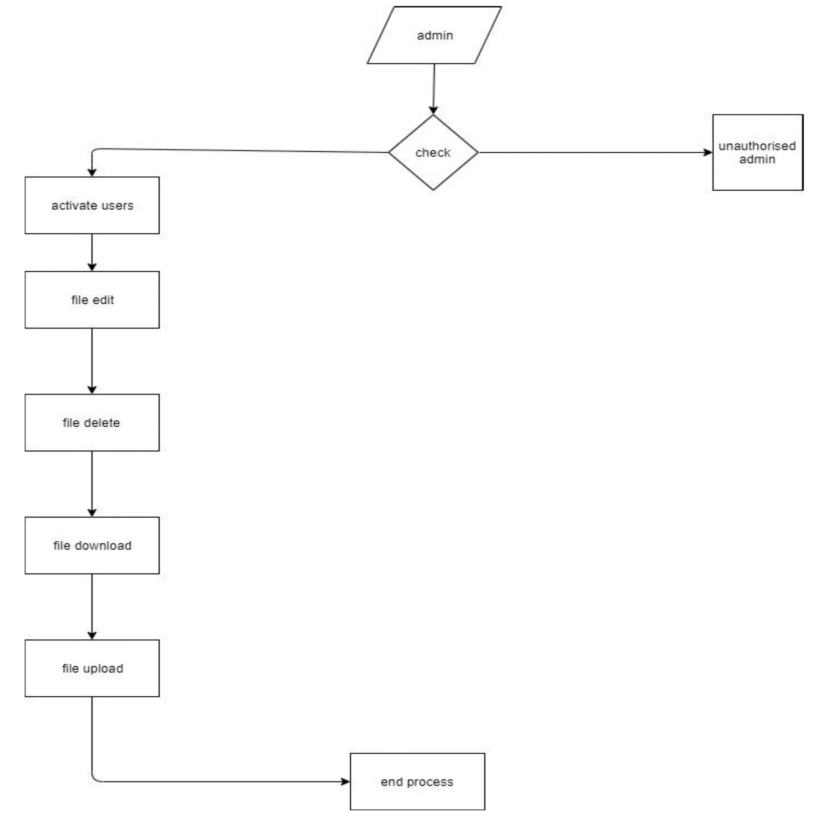
USER:

Slide 19
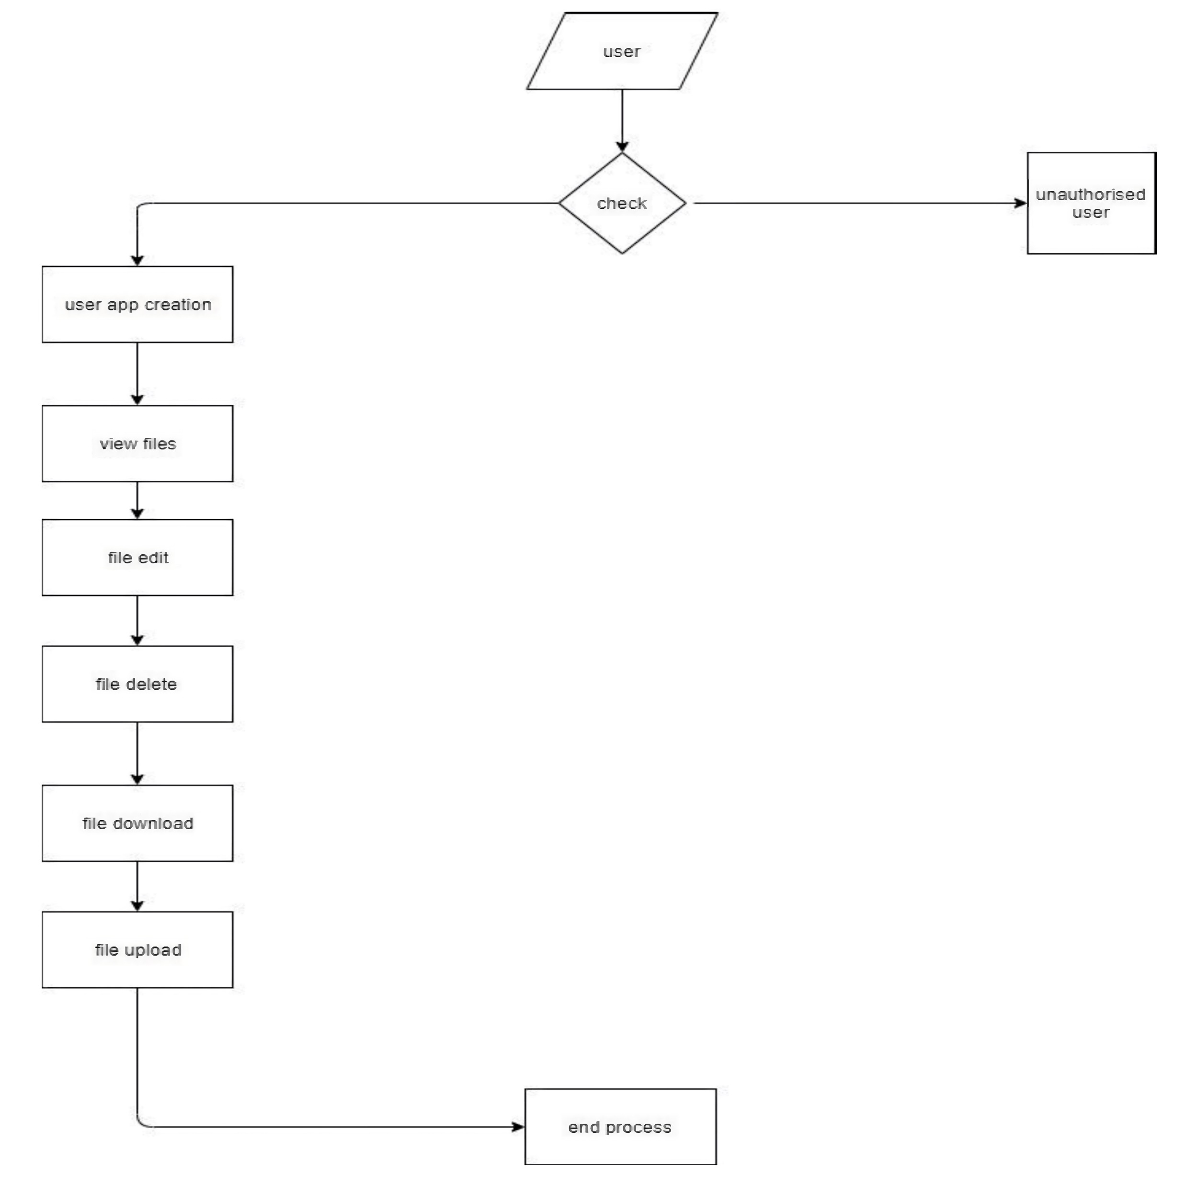
ADMIN:

Slide 20
Testing
Testing is a crucial phase in the development process to ensure that the system functions as expected. The system was rigorously tested for functionality, security, and performance. Test cases were developed to verify that user actions, such as file uploads and downloads, were properly authorized and processed by the cloud. The admin module was tested to ensure that it could effectively manage user accounts and cloud resources. This slide discusses the testing strategies employed and the results, which confirmed that the system meets its security and operational requirements.

Slide 21
Conclusion
The project successfully demonstrated the use of model-driven approaches to enhance cloud security through the creation of cloud monitors. These monitors ensure that the system adheres to both functional and security requirements, providing a robust and secure cloud environment. The implementation in Django, combined with validation through OpenStack, showed promising results, indicating that this approach could be further developed and extended to other cloud platforms. The project sets the stage for future work, including the integration of more advanced machine learning techniques to further enhance the system’s capabilities.

Slide 22
Thank you

